Slide 1

AIRBNB CASE STUDY
“Analysing Airbnb data to uncover trends in bookings
and customer preferences”
Dushyant Chouhan
07-10-2024

Slide 2
OBJECTIVE "The aim is to understand trends in Airbnb bookings across various cities and identify factors impacting customer satisfaction and pricing."

Slide 3
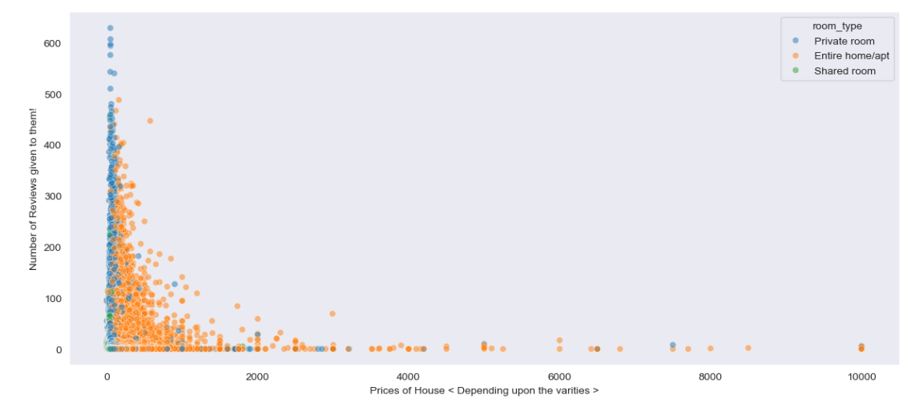
Prices of House Depending upon the varities
Lower-priced houses get more reviews, and at higher prices,
"Entire home/apt" listings dominate but receive fewer reviews.

Slide 4
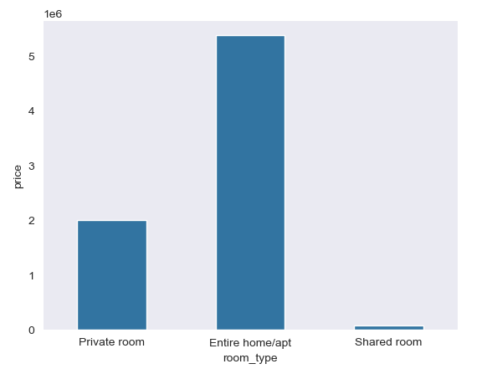
Price VS Room_Type
The bar chart indicates that "Entire home/apt" listings have the highest total price, followed by "Private room," while "Shared room" has a significantly lower total price compared to the other room types.

Slide 5
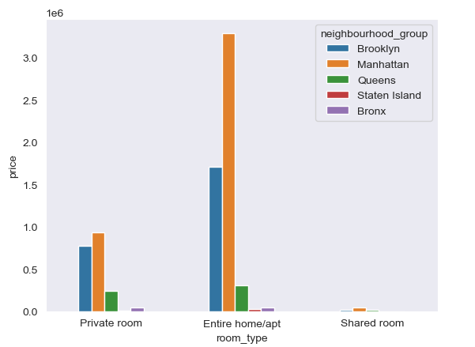
Room_types VS neighbourhood_group
The graph shows that the price of Airbnb listings in New York City varies significantly based on both the neighborhood and the room type. Entire home/apt listings are generally more expensive than private rooms and shared rooms, and listings in Manhattan are significantly more expensive than listings in other boroughs.

Slide 6
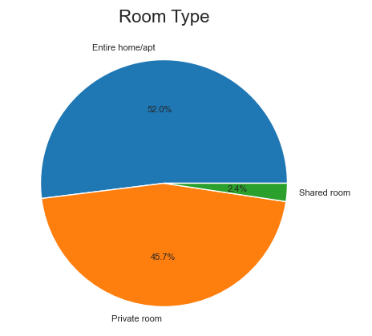
Room_type
The pie chart shows the distribution of room types on Airbnb. The most common room type is Entire home/apt, followed by Private room and Shared room.

Slide 7
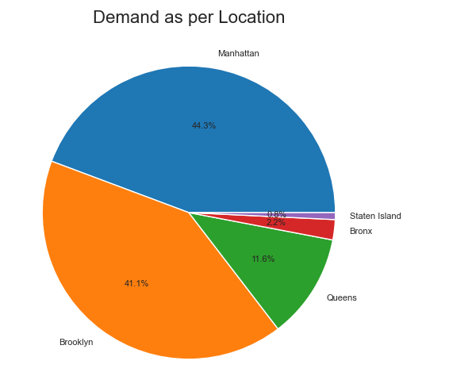
Demans As Per Location
The pie chart shows the distribution of Airbnb demand across different boroughs in New York City. Manhattan has the highest demand, followed by Brooklyn and Queens. Staten Island and Bronx have significantly lower demand.

